Slide 1

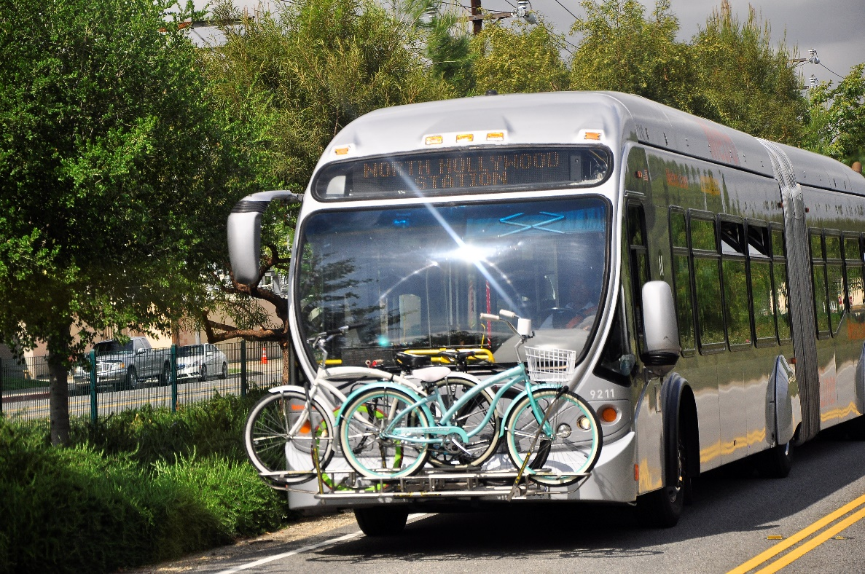
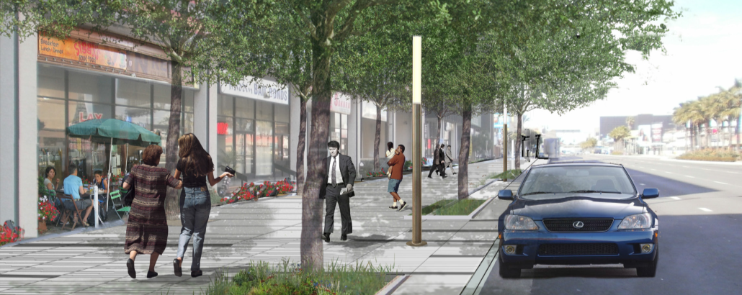
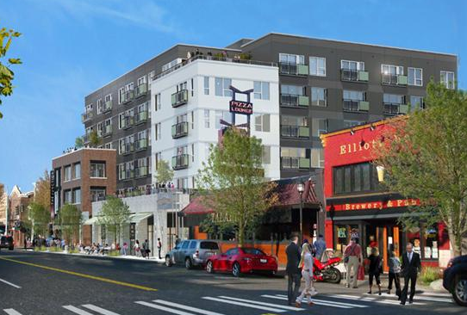
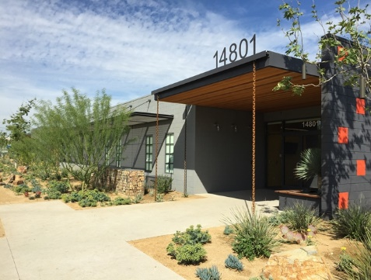
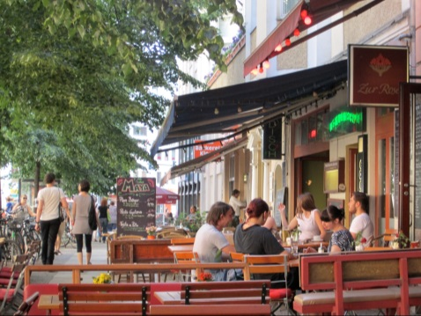

orange line TRANSIT NEIGHBORHOOD PLAN
PRESENTATION TO VAN NUYS AND NORTH HOLLYWOOD NEIGHBORHOOD COUNCILS
Photo: Mission Meridian(Moule & Polyzoides)
Project partially funded by Metro

Slide 2
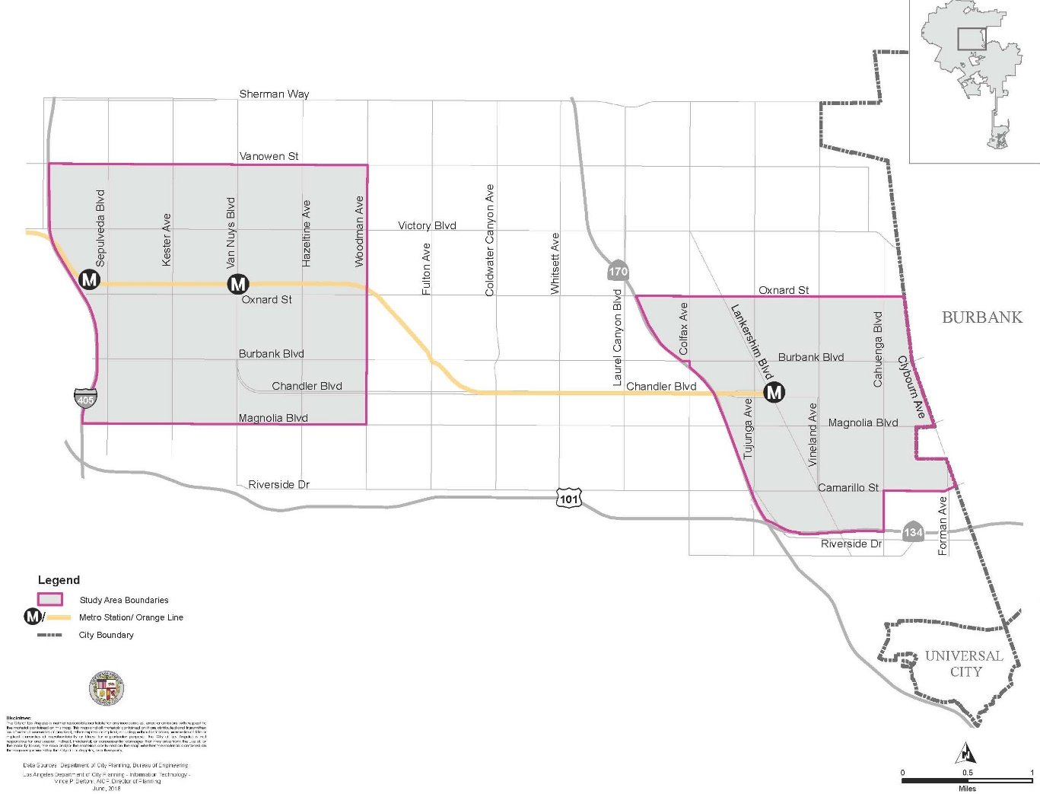
Study Areas in Context
 | Population (2018) | Land Area | Median Household Income
Van Nuys/ Sepulveda Station Area | 62,000 | 4.5 sq mi | $46,127
North Hollywood Station Area | 43,000 | 2.85 sq mi | $45,930
City of LA | 3.95 million | 469 sq mi | $54,501

Slide 3
Project Timeline
2016
  Initial Workshops (July)
  Outreach to local stakeholders (Neighborhood Councils, BIDs, VICA, ACT-LA)
2017
  Ongoing work on zone development with re:code LA team
  Draft Market Study
  Initial Concepts community meetings (November)
2018
  Updated Concepts presentations to Neighborhood Councils (July-Aug)
  EIR Scoping Meeting (July)
2019
  Ongoing work on EIR and zone development
  Community Outreach and Open Houses (Oct 2019-Jan 2020)

Slide 4






Revised Plan
ORANGE LINE TRANSIT NEIGHBORHOOD PLANS
Overview: Timeline
2016
2017
2018
2019
2020
2020-2021
Community Engagement
Plan Development
Concept Plan & Public Feedback
Environmental Review
Adoption

Slide 5





ORANGE LINE TRANSIT NEIGHBORHOOD PLANS
Overview: Timeline
Revised Plan & Adoption
2016
2017
2018
2019
2020-2021
Community Engagement
Plan Development
Concept Plan & Public Feedback
Environmental Review
Implementation
Focus Groups with community groups, BIDs
Presentations to Neighborhood Councils
4 Public Visioning Workshops
Walking Tours
Notes:
6,500 Mailers (in English and Spanish)
50+ Flyers (in English and Spanish) posted at libraries, community organizations, and cafes
10+ Presentations to Neighborhood Councils, BIDs, and other stakeholders
100+ Facebook Follows
XXX Website Hits

Slide 6

ORANGE LINE TRANSIT NEIGHBORHOOD PLANS Overview: Timeline
Revised Plan & Adoption
2016
2017
2018
2019
2020-2021
Community Engagement
Plan Development
Concept Plan & Public Feedback
Environmental Review
Implementation
Review of Existing Regulations
Market Study
Feasibility Analysis
Initial Concepts

Slide 7
ORANGE LINE TRANSIT NEIGHBORHOOD PLANS Overview: Timeline
Revised Plan & Adoption
2016
2017
2018
2019
2020-2021
Community Engagement
Plan Development
Concept Plan & Public Feedback
Environmental Review
Implementation
Share initial concepts and visions
Collect feedback
Make revisions

Slide 8
ORANGE LINE TRANSIT NEIGHBORHOOD PLANS
Next Steps: Timeline
Revised Plan & Adoption
2016
2017
2018
2019
2020-2021
Community Engagement
Plan Development
Concept Plan & Public Feedback
Environmental Review
Environmental Review
Implementation
Conduct public Scoping Meeting
Analyze potential environmental impacts

Slide 9
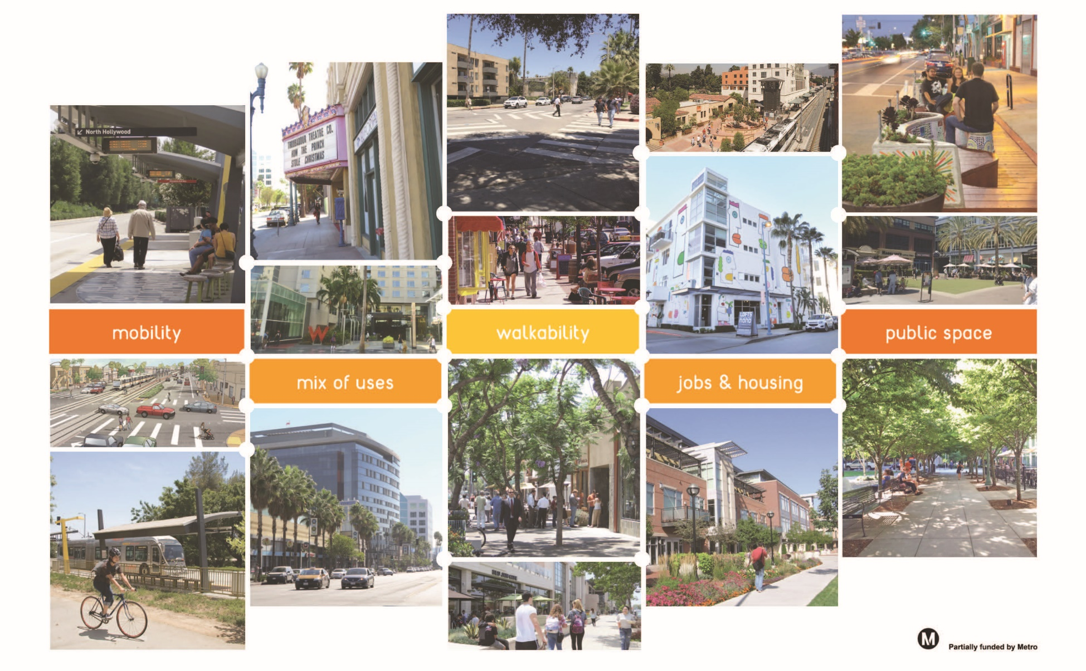
TRANSIT NEIGHBORHOOD PLAN GOALS
Create opportunities for more jobs & housing of all types near transit
Foster a vibrant mix of uses within each station area
Increase access to a variety of mobility options for all
Improve quality of public spaces for residents, employees & visitors

Slide 10
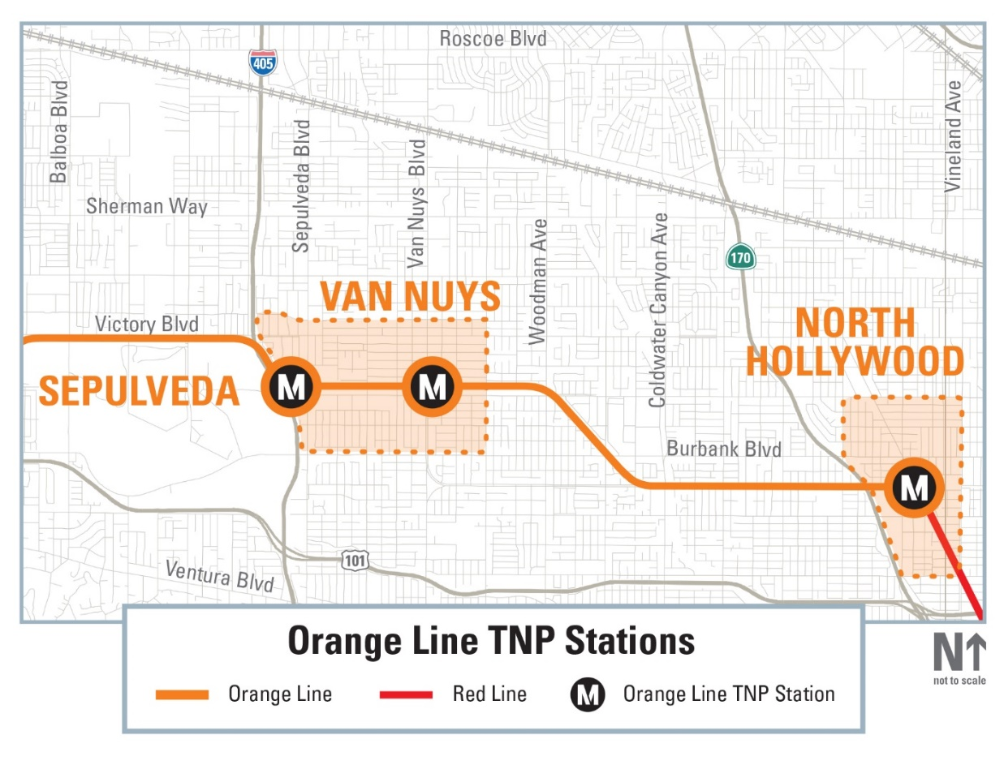
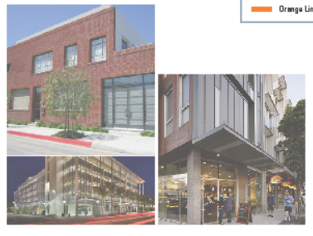
ORANGE LINE TRANSIT NEIGHBORHOOD PLAN
Vision for 2040: Van Nuys and Sepulveda Stations
Enhance the vibrancy of the Civic Center & Van Nuys corridor with day & evening activity; protect existing employment uses in the industrial corridor & accommodate new production & service types; encourage mixed-use development to activate the Sepulveda station area; and promote a variety of housing types.
Van Nuys &
Sepulveda Station Area
Vision:
Regional Gateway –
Civic Center & Jobs Hub

Slide 11

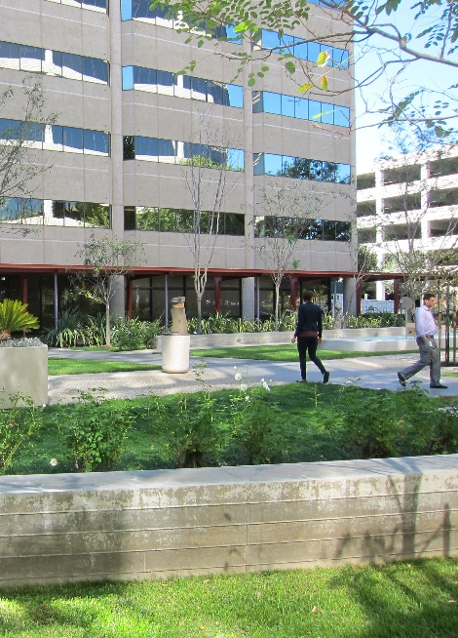
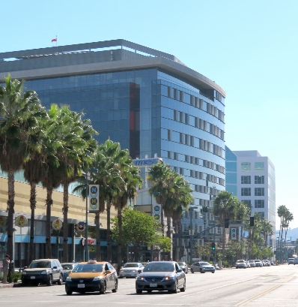
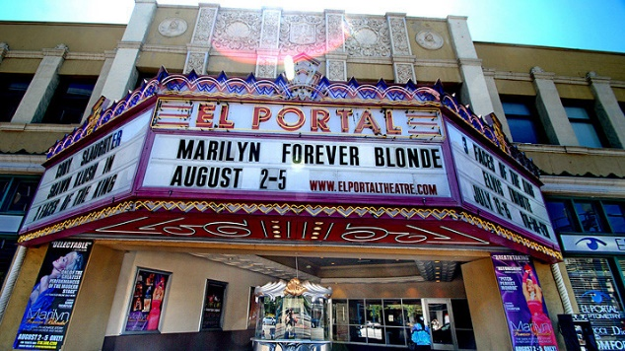
ORANGE LINE TRANSIT NEIGHBORHOOD PLAN
Vision for 2040: North Hollywood Station
Reinforce NoHo’s character as a regional arts destination and creative jobs hub, with theaters, restaurants, office space and varied housing types; encourage public amenities including pedestrian-friendly streetscapes, a mix of retail and services, and open space.
North Hollywood
Station Area
VISION:
Creative Industry & Performing Arts Hub

Slide 12
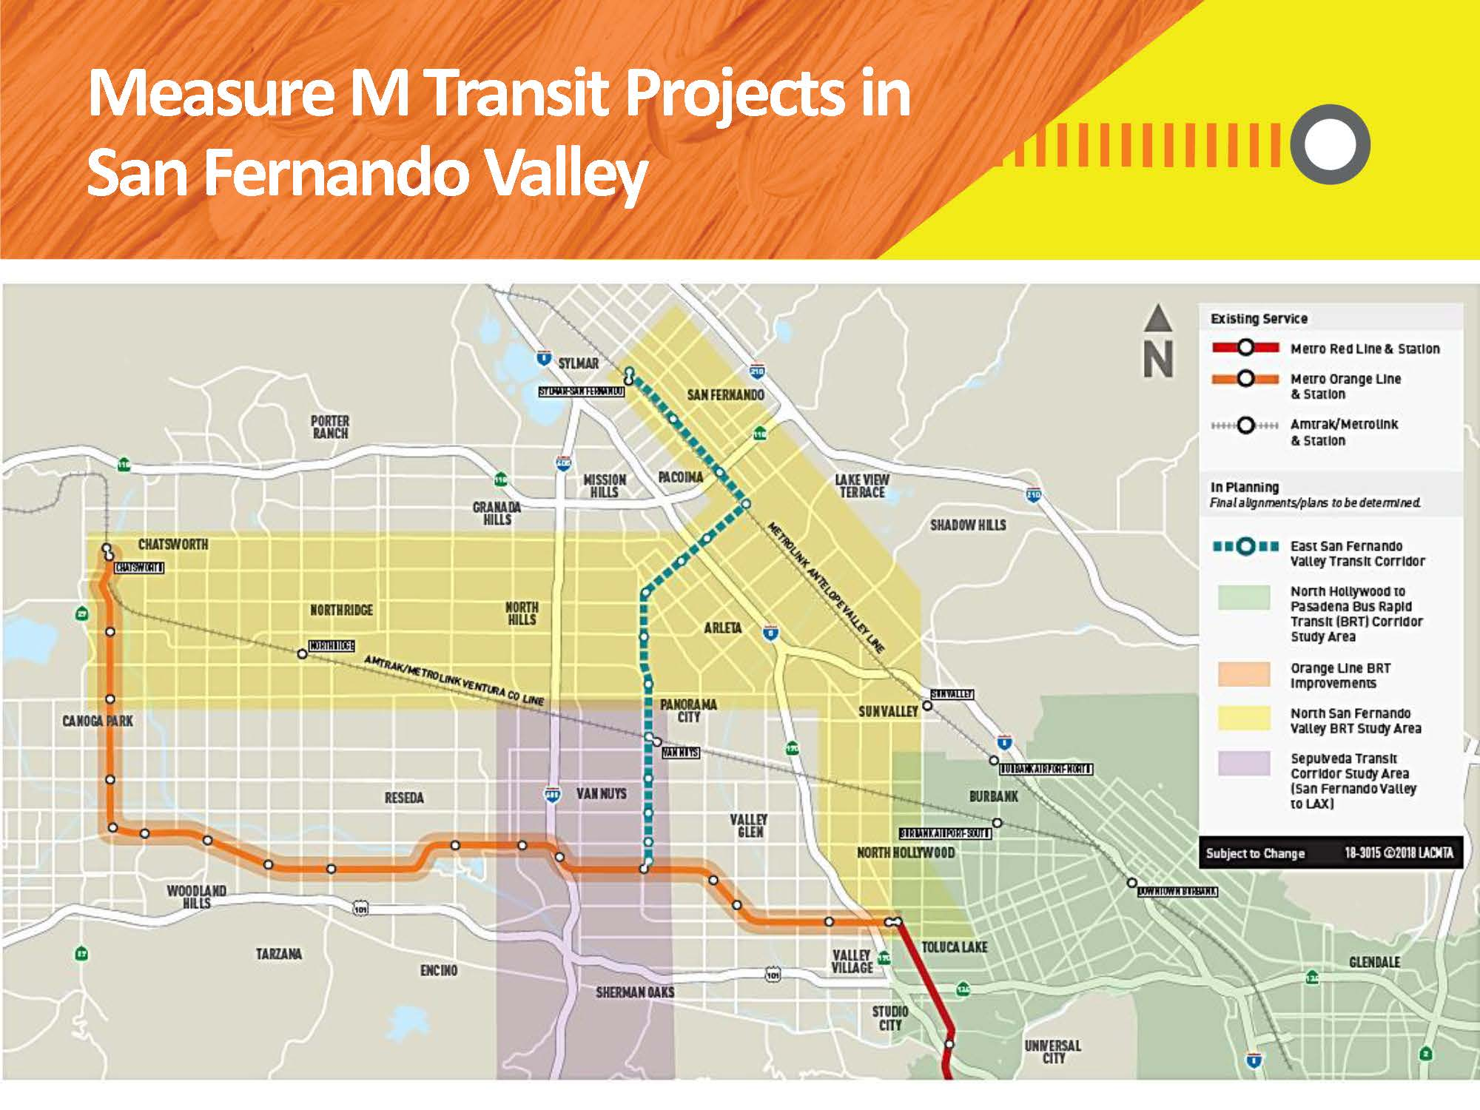
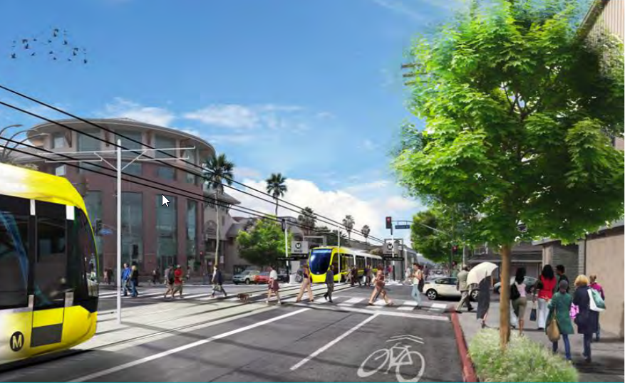
ORANGE LINE TRANSIT NEIGHBORHOOD PLAN
The Future of Mobility in the San Fernando Valley
Rendering of proposed Van Nuys Blvd. light rail

Slide 13












ORANGE LINE TRANSIT NEIGHBORHOOD PLAN
What We’ve Heard – Key Themes
PLACES
GETTING AROUND
LIVABILITY
DESIGN
DESIRE FOR DESTINATIONS & NEIGHBOROHOD-SERVING USES
OPTIONS AROUND MOBILITY
KEEP DENSITY CLOSER TO STATIONS
SHADE FROM THE VALLEY HEAT
DIVERSITY OF TYPES & COST OF HOUSING
OPEN SPACE & GREEN SPACE
ADEQUATE PARKING
SAFETY & CLEANLINESS
NEED FOR AFFORDABLE HOUSING & SOCIAL SERVICES
PEDESTRIAN-FRIENDLY DESIGN & WAYFINDING
AMENITIES NEAR BIKE PATH
SAFE CROSSINGS
Notes:
Places to go (more neighborhood-serving commercial: grocery stores, cafes, restaurants)
Options around Mobility (pick-up and drop-off for Uber/Lyft, bicycle, walking, shuttles)
Shade from the Valley heat (trees and awnings)
Open space and green spaces (green alleys, pocket parks, etc.)
Amenities along Bike Path (lockers, showers, repair stations)
Connections to LA River
Diversity of Types and cost of housing
Safety and cleanliness (at stations, on bike path, on streets)

Slide 14
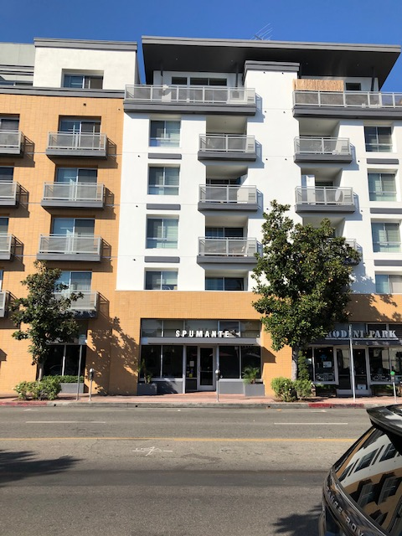
ORANGE LINE TRANSIT NEIGHBORHOOD PLAN
Key Strategies: Housing
Generous system of bonus development rights will incentivize public benefits (affordable housing, open space, etc.)
Ensure compliance with State Density Bonus and local Transit-Oriented Communities program
Allow Fourplex/Triplex zones in selected R1 areas to accommodate anticipated growth
Regulate form and frontage to ensure compatibility with existing neighborhood form
Overall Goal: Maximize production of new housing, including affordable units, while encouraging preservation of existing rent-stabilized units

Slide 15
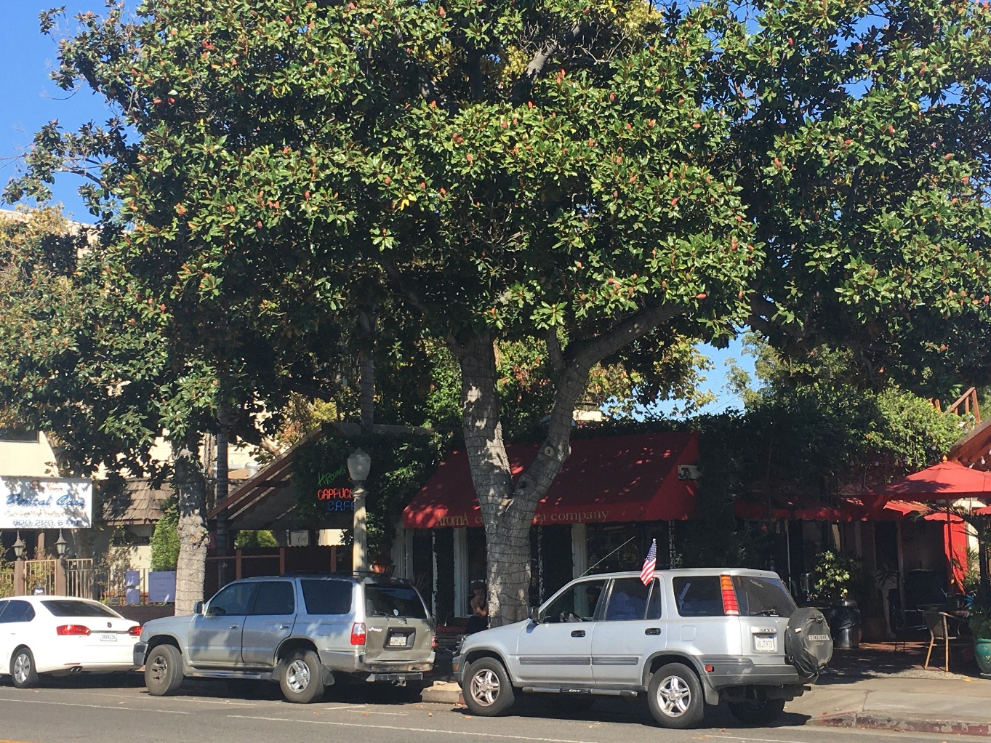
ORANGE LINE TRANSIT NEIGHBORHOOD PLAN
Key Strategies: Residential Amenity Zones
Goal: Encourage complete, walkable neighborhoods by allowing select neighborhood-serving commercial uses in residential areas
  Examples: Daycare, salon/barbershop, bodegas/tienditas, coffee shops
Regulations TBD: Parking, frontage, use, limits on floor size, hours
“Residential Amenity” zones will have same zoning metrics as Residential zones, with slightly increased development rights to incentivize mixed uses

Slide 16
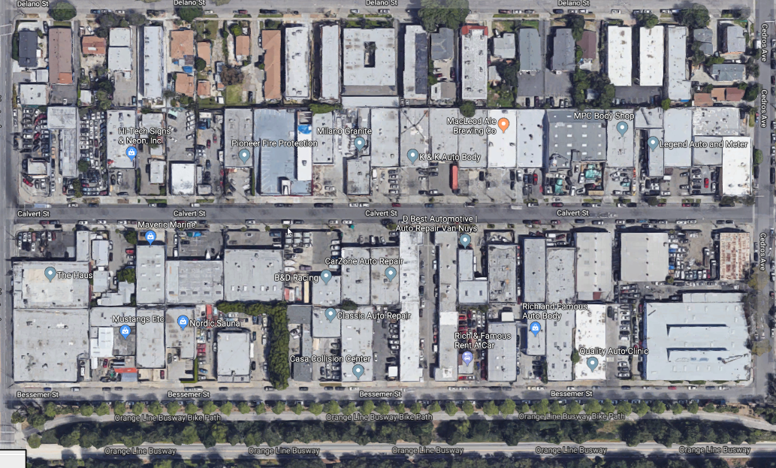
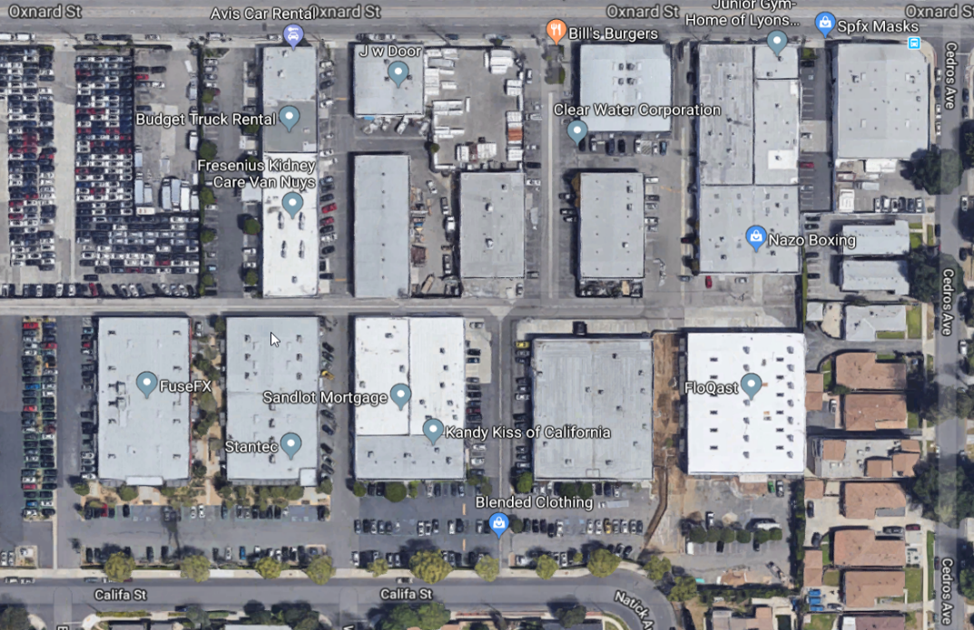
ORANGE LINE TRANSIT NEIGHBORHOOD PLAN
Key Strategies: The Future of Industrial Land
ISSUES
Smaller lot size than typical Ind. areas
Heterogeneous mix of uses & industries, regardless of zoning on the ground
Large number of variances granted b/c of auto-body spray booths
OPPORTUNITIES
New re:code zoning categories that allow detailed regulation of use & frontage
New types of businesses with need for Creative Office space
Proximity to incoming transit service

Slide 17
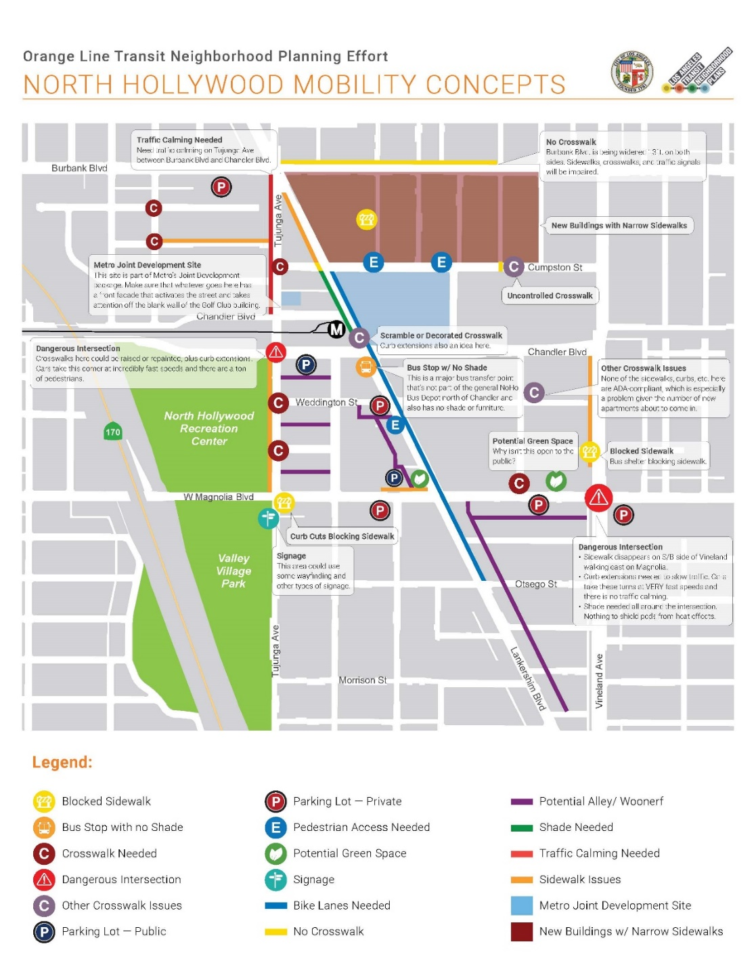
ORANGE LINE TRANSIT NEIGHBORHOOD PLAN
Key Strategies: First Mile/Last Mile Plans
Metro grant requires TNP team to study pedestrian, bike, and bus links to new transit
LADCP will collaborate with LADOT, Bureau of Street Services, and City Council to prioritize street improvements
FM/LM studies have identified need for street trees, wayfinding, and lighting improvements

Slide 18
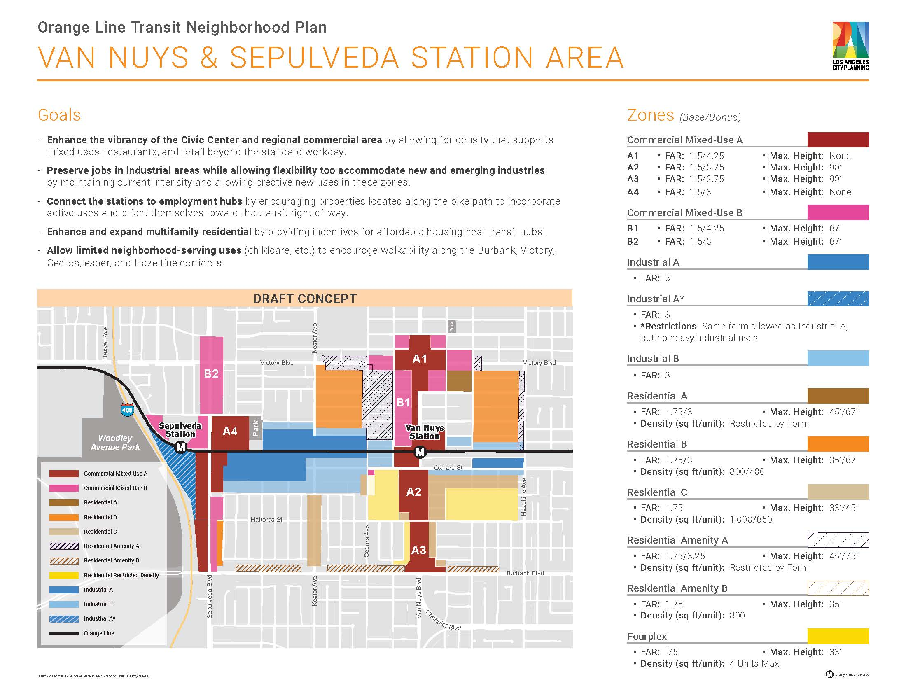

Slide 19
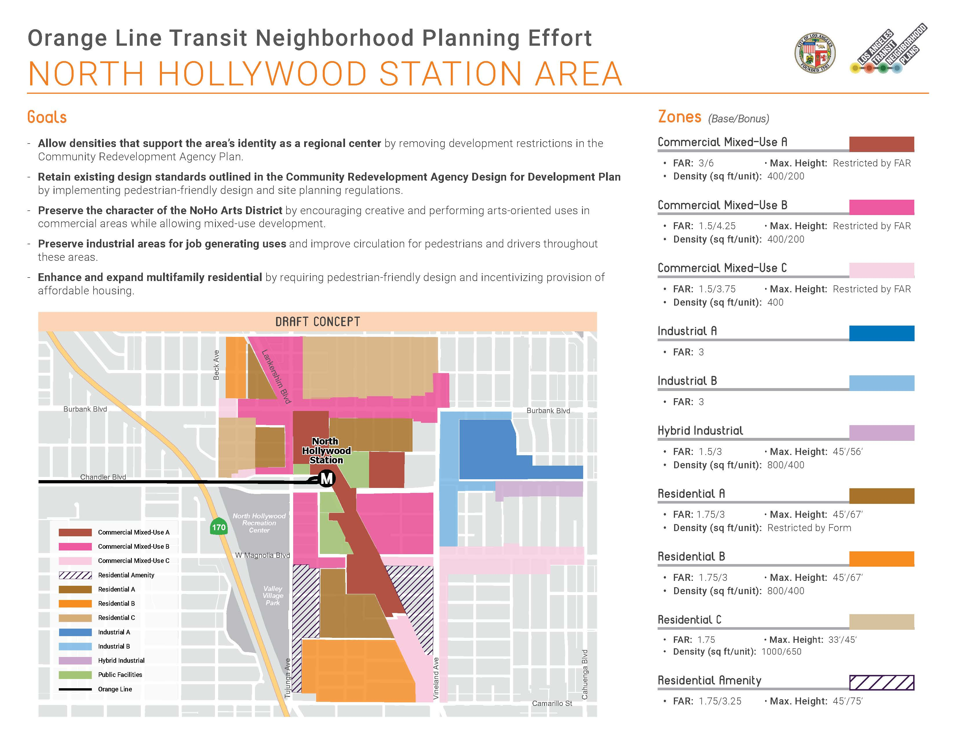

Slide 20
ORANGE LINE TRANSIT NEIGHBORHOOD PLAN
Next Steps
Determine details of Public Benefits Incentive System
Work with new zoning code to determine Form, Frontage, and Use regulations
Continue writing Draft Environmental Impact Report
OPEN HOUSE MEETINGS
Van Nuys
  Wed. January 22, 5-8 p.m.
  Marvin Braude Bldg. Room 1A & 1B, 6262 Van Nuys Blvd.
  North Hollywood
  Thurs. January 30, 5-7:30 p.m.
  North Hollywood Regional Library
  5211 Tujunga Ave.

Slide 21
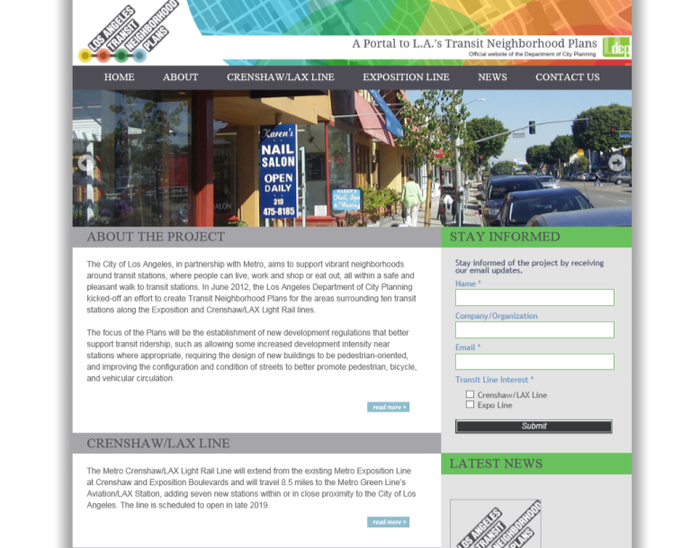


ORANGE LINE TRANSIT NEIGHBORHOOD PLANS
Next Steps: Stay Connected
David Olivo
Senior City Planner
David.Olivo@lacity.org
818.374.9915
Lynell Washington
City Planner
Lynell.Washington@lacity.org
818.374.7556
Jordan Fraade
City Planning Assistant
Jordan.Fraade@lacity.org
818.374.9902
Visit us at:
@ www.latnp.org
www.facebook.com/latnp
www.twitter.com/latnp

